Slide 1


Slide 2
SQL In A Nutshell
CSCI 440 in 50 Minutes...

Slide 3

SQL In A Nutshell
In this lecture, I’m going to give you the entire CSCI 440 course in about 50 minutes
Why?
Because the accreditors say so
It’s useful to see it
Head to https://www.sqlitetutorial.net/ And follow along...
Notes:
Can be found online… but I can’t link to it

Slide 4
What is a Database
A database is a system that organizes data into a collection of Tables
A table is kind of like a spreadsheet, but the columns have a specific type
E.g. Strings, Integers, Decimal Numbers, etc.
Notes:
Can be found online… but I can’t link to it

Slide 5
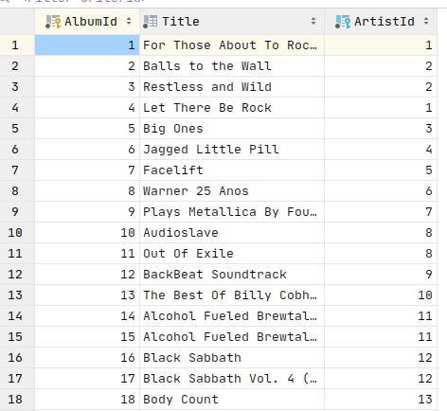
What is a Database
Rows in a database typically have a key associated with them
Here we have an Albums table, with an AlbumId column
This is the key for this table
Notes:
Can be found online… but I can’t link to it

Slide 6
What is a Database
Rows can have Foreign Keys to other tables (or to themselves)
This table has a Foreign Key to the Artists table
Notes:
Can be found online… but I can’t link to it

Slide 7
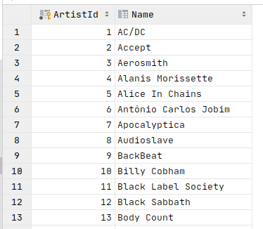
What is a Database
Note that the first row in the album table points to the artist with ArtistID 1
This artist is AC/DC
Foreign keys are analogous to pointers in C
Notes:
Can be found online… but I can’t link to it

Slide 8
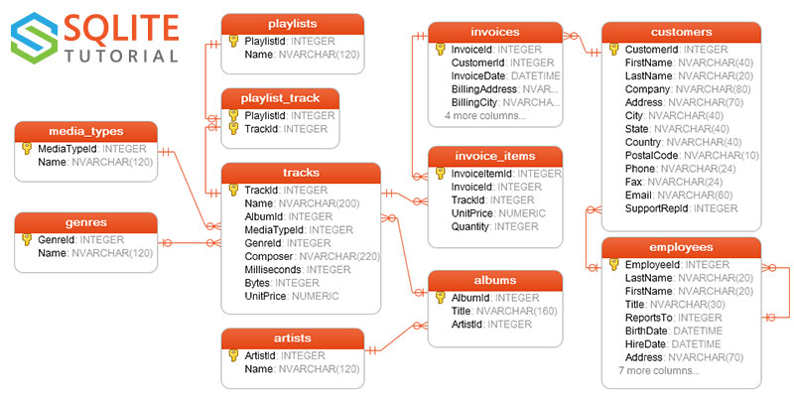
What is a Database
A collection of tables with foreign keys are a schema
A schema can be represented graphically
We will be using the chinookdb schema for our examples, from the SQLite Tutorial site
Notes:
Can be found online… but I can’t link to it

Slide 9
ChinookDB Schema

Slide 10
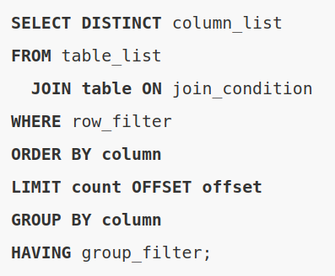
SQL
SQL stands for Standard Query Language
It is a standard for Creating, Reading, Updating and Deleting data in a database
CRUD
It is declarative, rather than imperative
Notes:
Can be found online… but I can’t link to it

Slide 11
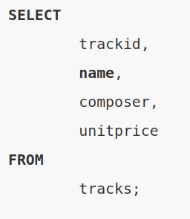
SQL - Select
A SQL select retrieves data from a table or collection of tables
Here we are selecting some fields from the tracks table
You can run it here: https://www.sqlitetutorial.net/tryit/query/sqlite-select/#3
Notes:
Can be found online… but I can’t link to it

Slide 12
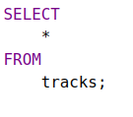
SQL - Select
If you wish to retrieve all fields you can use the * operator
This will retrieve all fields of all rows from the tracks table
Notes:
Can be found online… but I can’t link to it

Slide 13
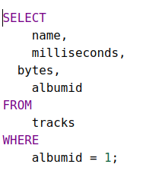
SQL - Select
Often you wish to restrict the rows that are returned from a SELECT
To do this, you use the WHERE clause
This query will return all tracks whose albumid is 1
Notes:
Can be found online… but I can’t link to it

Slide 14
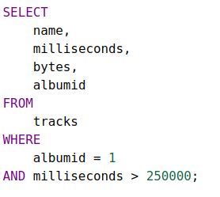
SQL - Select
Constraints can be added with logical operators like AND or OR
This query will return all tracks whose albumid column is 1 and whose milliseconds (run time) is greater than 250 seconds
Notes:
Can be found online… but I can’t link to it

Slide 15
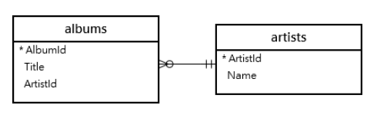
SQL - Joins
Often you want to combine tables to produce some final information
This is achieved with the JOIN operator
Note that Album has a Foreign Key to Artist
This means that each album row has a pointer to artist, so multiple albums can belong to a single artist
Notes:
Can be found online… but I can’t link to it

Slide 16
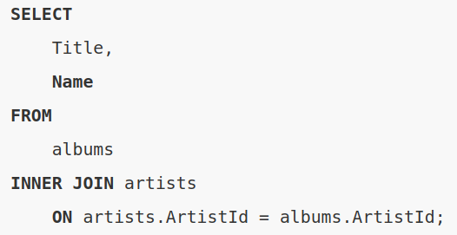
SQL - Joins
If you want to return each album title as well as the artists names, you need to use a JOIN statement
The ON clause can be any sort of relational expression, but typically is equality on a foreign key
Notes:
Can be found online… but I can’t link to it

Slide 17
SQL - Joins
There are different types of joins
Inner Join - only return exact matches
Outer Join - return rows that don’t have a corresponding match
Most times you want an inner join
Notes:
Can be found online… but I can’t link to it

Slide 18
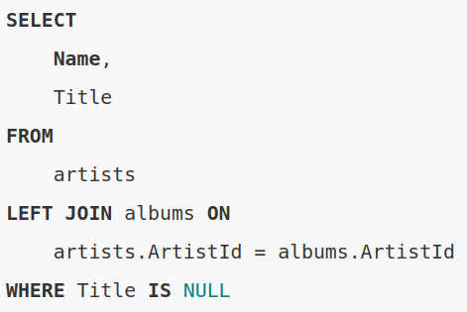
SQL - Joins
Joins can be combined with WHERE conditions
The WHERE condition can apply to any table in the query
In this case, artist or albums
Notes:
Can be found online… but I can’t link to it

Slide 19
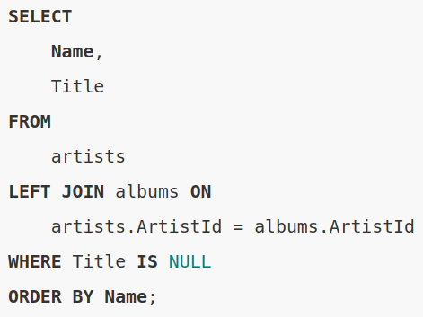
SQL - Order By
You can order the results of a query by using the ORDER BY clause
This example will return artists in ascending name
You can use the DESC keyword (or similar) to order the other direction
Notes:
Can be found online… but I can’t link to it

Slide 20
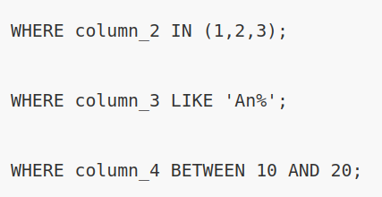
SQL - IN, LIKE, BETWEEN
You can use IN expressions to test membership in a collection
You can use LIKE expressions to test string matching
% is the wildcard
You can use BETWEEN to express a range
Notes:
Can be found online… but I can’t link to it

Slide 21
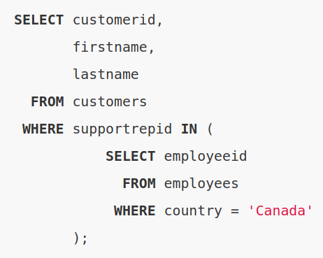
SQL - SubQueries
You can use the IN expression with nested sub-queries to create more complex
Here we find all customers whose support rep lives in Canada
Notes:
Can be found online… but I can’t link to it

Slide 22
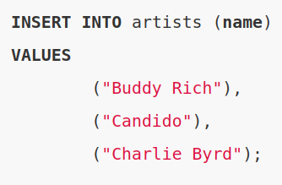
SQL - Insert
You can use the INSERT statement to create a new row in a table
A table specification may auto-populate some columns (e.g. the key for the table)
Notes:
Can be found online… but I can’t link to it

Slide 23
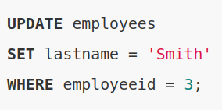
SQL - Update
To update a value, use the UPDATE statement
Here we update the employee with the ID 3 to have the last name ‘Smith’
Notes:
Can be found online… but I can’t link to it

Slide 24
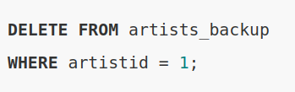

SQL - Delete
To delete a value, use the DELETE statement
In the first example, we delete the row with the artistid of 1 in the artists_backup table
Note that this where clause is general and can match many rows, as in the second example. Be careful!
Notes:
Can be found online… but I can’t link to it

Slide 25
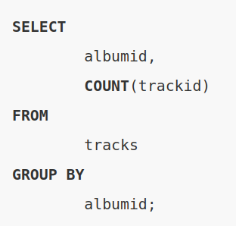
SQL - Group By
SQL supports aggregation of multiple rows into a single result via the GROUP BY clause
Here we group the tracks table by albumid
We use COUNT(trackid) to count how many trackids were grouped into a single result row
Notes:
Can be found online… but I can’t link to it

Slide 26
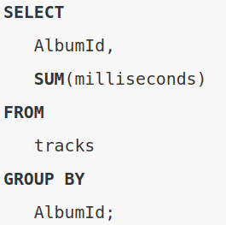
SQL - Group By
Aggregations usually include aggregation functions in the SELECT:
COUNT
AVG
MAX
MIN
SUM
Notes:
Can be found online… but I can’t link to it

Slide 27
SQL - Group By
Here we are summing up all the milliseconds of tracks on a given album
Very useful for reporting!
Notes:
Can be found online… but I can’t link to it

Slide 28
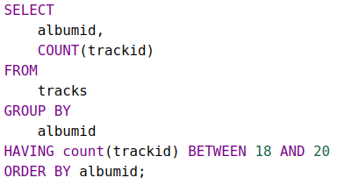
SQL - Having
Sometimes you want to apply a condition to the results of the aggregation
To do so, you use the HAVING clause
This will return all album ids with between 18 and 20 tracks on them
Notes:
Can be found online… but I can’t link to it

Slide 29
SQL - Having
Note that this is distinct from the WHERE clause
The WHERE clause applies to the individual rows
The HAVING clause applies to the aggregated rows
Notes:
Can be found online… but I can’t link to it

Slide 30
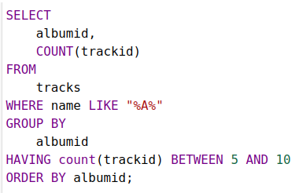
SQL - Having
Here we see both a WHERE clause and a HAVING clause
The WHERE clause filters to only tracks with an “A” in the name
The HAVING clause then filters any aggregated rows with a count outside the given range
Notes:
Can be found online… but I can’t link to it

Slide 31
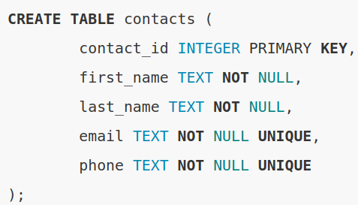
SQL - DDL
DDL (Data Definition Language) is the SQL used to define tables
CREATE creates a table
Here we create a Contact table with a few fields
Notes:
Can be found online… but I can’t link to it

Slide 32
SQL - DDL
The contact_id field is an integer and is the primary key for this table
The primary key is the main column (or columns) to refer to a row by
first_name and last_name are Strings and may not be null
email and phone are also strings and may not be null, and additionally must be unique in the table
Notes:
Can be found online… but I can’t link to it

Slide 33
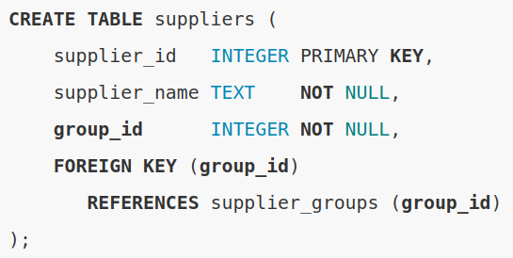
SQL - DDL Foreign Keys
A Foriegn Key Constraint may be applied to tables to tell the database that a column refers to another table
Here we have a group_id column in the table suppliers, which refers to the group_id column in another table, supplier_groups
Notes:
Can be found online… but I can’t link to it

Slide 34
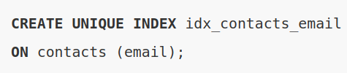
SQL - DDL Indexes
Databases support a data structure known as an index, which helps make queries run faster
Here we add an index on the email column in our contacts table
Email lookups will now be much faster
But Contact inserts will be slower!
Notes:
Can be found online… but I can’t link to it

Slide 35
SQL - DDL Data Types
Every database supports a different group of column types.
Some common ones:
VARCHAR, TEXT - Strings
Integer - integers (usually 64 bit)
Date, DateTime, Timestamp
Double, Float - Floating Point
Decimal - Fixed Precision
Blob - Binary data
Bool, Boolean - Boolean
Notes:
Can be found online… but I can’t link to it

Slide 36
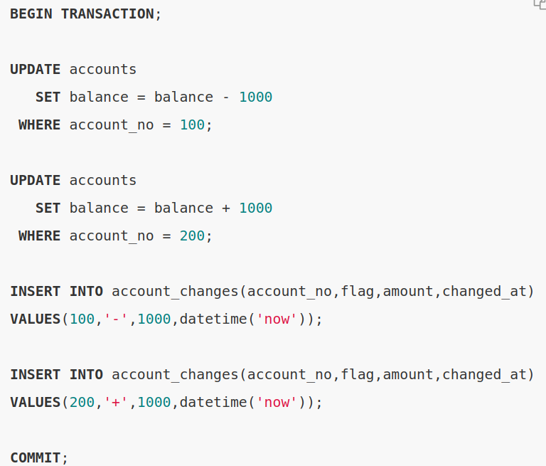
SQL - Transactions
Database support a concept of Transactions
Allows multiple operations to either all succeed or all fail as a single unit
Without transactions, this operation might fail halfway through and leave accounts in an inconsistent state!
Notes:
Can be found online… but I can’t link to it

Slide 37
SQL - ACID properties
Database transactions ensure that all changes are Atomic, Consistent, Isolated, and Durable (ACID)
Atomic - All succeed or all fail
Consistent - No ghost data
Isolated - As if no other transactions
Durable - Written to persistent storage before success is reported
Notes:
Can be found online… but I can’t link to it

Slide 38
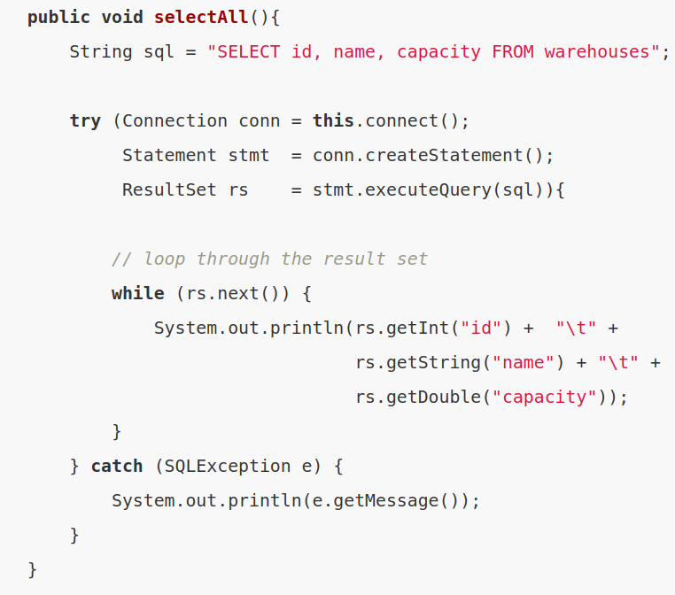
SQL - Java
Working with a database in Java is pretty easy
Use the JDBC API
Open a connection to the database
Create a statement
Execute a query
Iterate the results
Easy!
Notes:
Can be found online… but I can’t link to it

Slide 39
SQL In A Nutshell
Well, that was a whirlwind tour of SQL
Play around with the SQLite tutorial if you are interested in learning more about SQL: https://www.sqlitetutorial.net
If you are interested in a deep dive into databases and a database-driven web application, consider taking CSCI 440 next year

